Slide 1
Lecture 12
Introduction to Ethereum

Slide 2
Do not distribute ...
These slides are not always prepared by me.
Most of the content comes from the reference book
  Mastering Ethereum: Building Smart Contracts and Dapps
  Book by Andreas Antonopoulos and Gavin Wood Ph.D.
Some content comes from the blogs,
https://vas3k.com/blog/ethereum/ and https://medium.com/@preethikasireddy/how-does-ethereum-work-anyway-22d1df506369

Slide 3
What is Blockchain?
A linked list?
A linked list with hash pointers using a Cryptographic Hash Function
H( )
prev: H( )
prev: H( )
prev: H( )
data
data
data

Slide 4
What is a State Machine?
A state machine is any device storing the status of something at a given time.
State machines are represented using state diagrams.
Sounds familiar?

Slide 5
rdt_send(data)
sndpkt = make_pkt(data, checksum)
udt_send(sndpkt)
receiver
rdt_rcv(rcvpkt) &&
isNAK(rcvpkt)
Wait for call from above
Wait for ACK or NAK
rdt_rcv(rcvpkt) &&
corrupt(rcvpkt)
udt_send(sndpkt)
udt_send(NAK)
rdt_rcv(rcvpkt) && isACK(rcvpkt)
Λ
Wait for call from below
sender
rdt_rcv(rcvpkt) &&
notcorrupt(rcvpkt)
extract(rcvpkt,data)
deliver_data(data)
udt_send(ACK)

Slide 6
Why back to CNet?
Is there any relation between state machines and the blockchain?
Alternatively, can we model the Blockchain using a state machine?

Slide 7
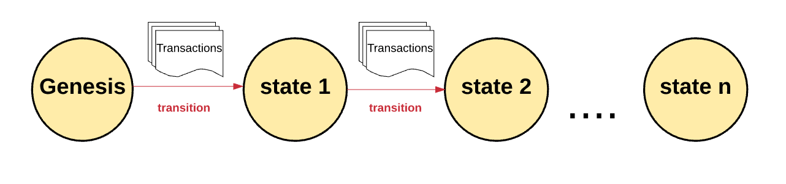
What is Blockchain?
A transactional decentralized state machine
Notes:
https://medium.com/@preethikasireddy/how-does-ethereum-work-anyway-22d1df506369

Slide 8
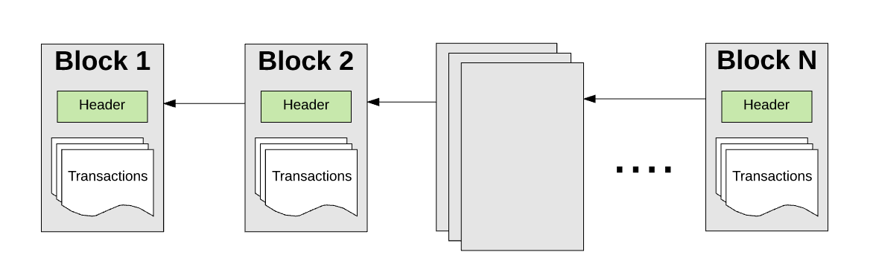
What is Blockchain?
A transactional decentralized state machine
Notes:
https://medium.com/@preethikasireddy/how-does-ethereum-work-anyway-22d1df506369

Slide 9
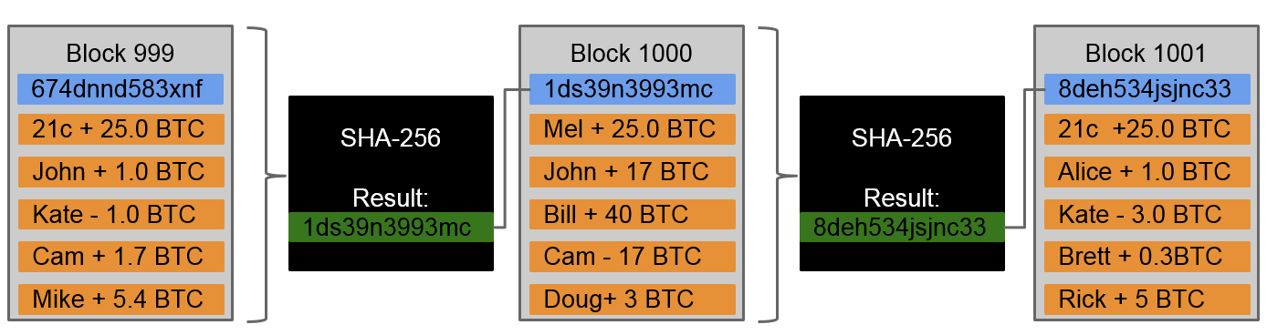
What about bitcoin blockchain?
A transactional decentralized state machine for ownership of bitcoins
Notes:
https://medium.com/@preethikasireddy/how-does-ethereum-work-anyway-22d1df506369

Slide 10
What about bitcoin’s blockchain?
The Bitcoin’s blockchain, tracks the state of units of bitcoin and their ownership.
You can think of Bitcoin as a distributed state machine, where transactions cause a global state transition, altering the ownership of coins.

Slide 11
How this can be generalized?
What if we can replace bitcoins with a general purpose data store?
It will open up numerous new use-cases and domains for blockchain

Slide 12
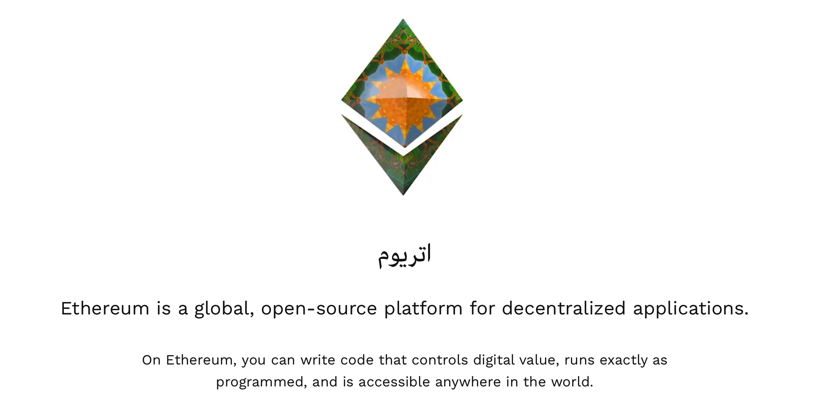

Slide 13
Ethereum: A General-Purpose Blockchain
Ethereum is also a distributed state machine.
Instead of tracking only the state of currency ownership, Ethereum tracks the state transitions of a general-purpose data store,
  a store that can hold any data expressible as a key–value tuple.
  A key–value data store holds arbitrary values, each referenced by some key; for example, the value “Mastering Ethereum” referenced by the key “Book Title”.

Slide 14
Ethereum: A General-Purpose Blockchain
Ethereum has memory that stores both code and data, and it uses the Ethereum blockchain to track how this memory changes over time.
Like a general-purpose stored-program computer, Ethereum can load code into its state machine and run that code, storing the resulting state changes in its blockchain.

Slide 15
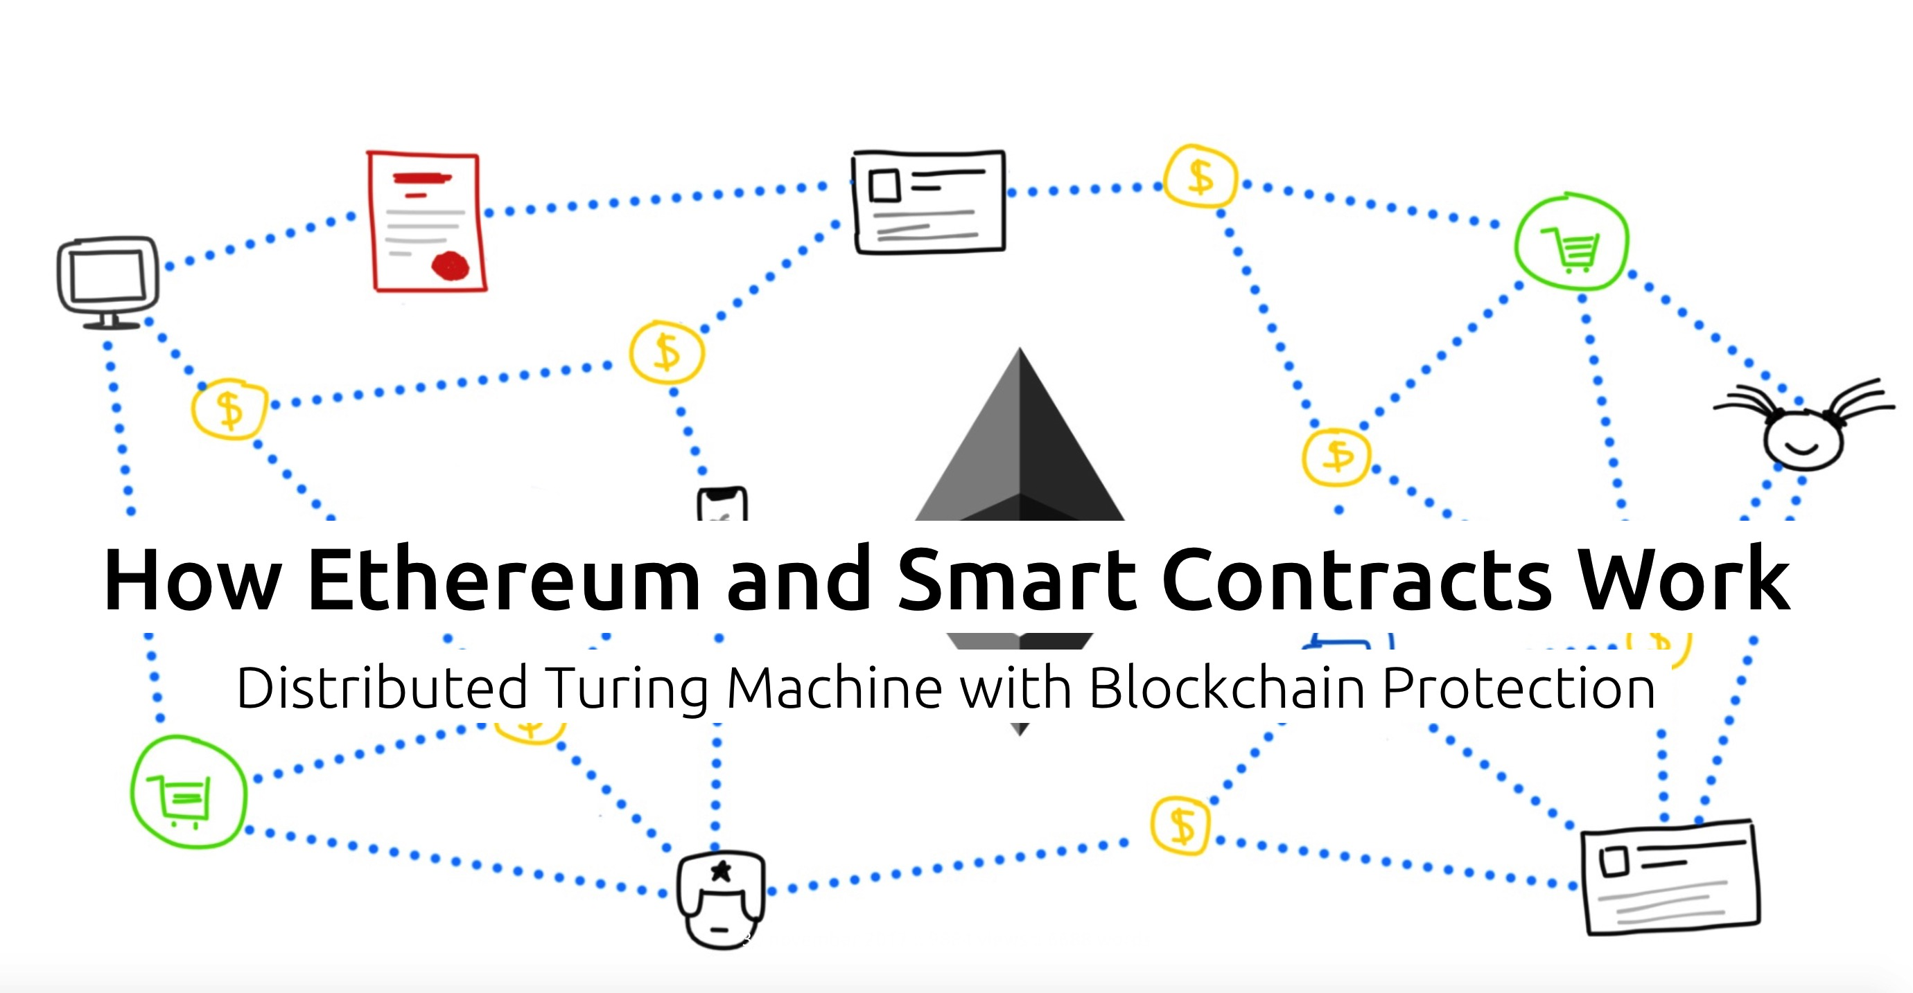
https://vas3k.com/blog/ethereum/

Slide 16
The need for agreements
In everyday life, we always make agreements based on “if… then” principle, regarding everything, not only finance.
If you do this, I’ll do that ...ideas/examples?

Slide 17
The need for agreements
The main problems about agreements are that nobody can really guarantee the fulfillment.
To avoid these problems business uses contracts:
  Trained people fill the papers with special words,
  cover them with stamps and signatures
  so that there is something to bring to the court ..

Slide 18
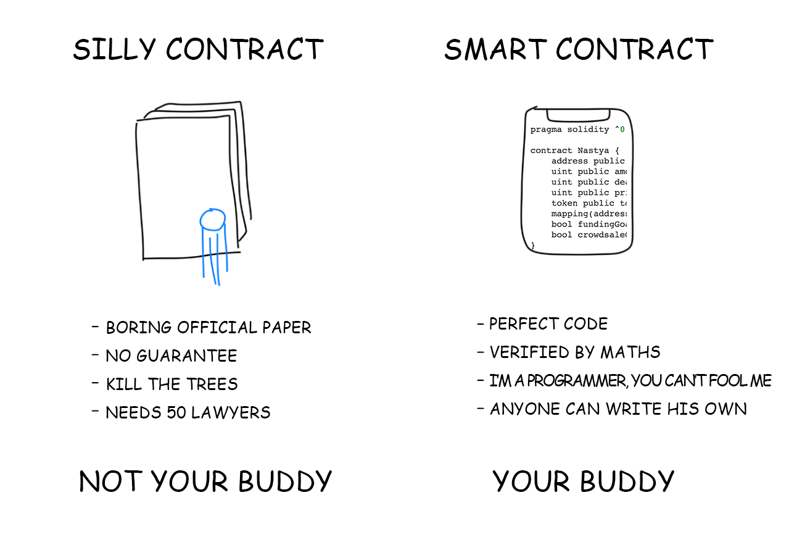

Slide 19
Alex and the smart contract

Slide 20
Alex and Kate
Alex is going to visit another city and need to rent an apartment there.
He finds the following ad – a girl named Kate offers an apartment in the very center for $300 per month.
This sounds too good to be true!

Slide 21
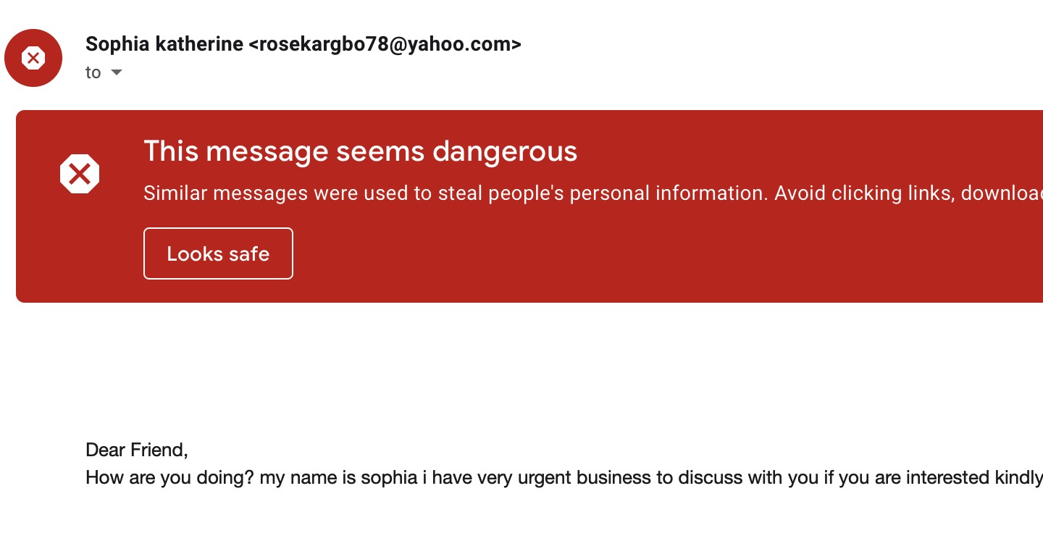
Alex and Kate
Kate and Alex ain’t familiar so couldn’t trust each other.
  Kate is afraid that Alex could change his mind at the very last moment.
  Alex knows Kate can be an anyone impersonating Kate.

Slide 22
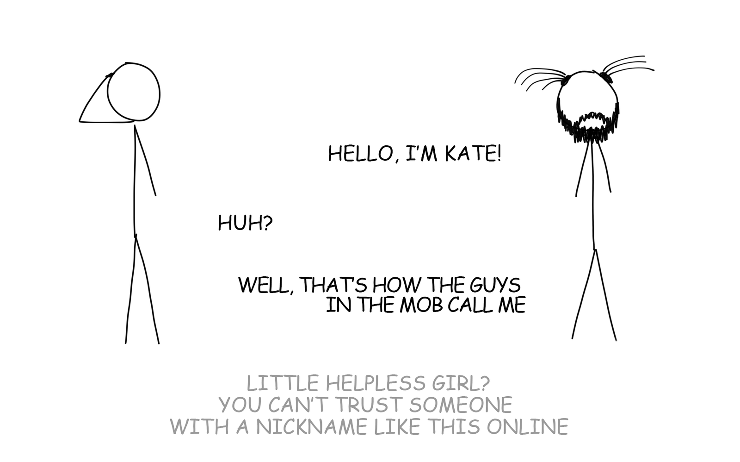

Slide 23
What can be done?
There are two traditional ways to get the things sorted:
  Alex and Kate sign a long agreement. Finally, Alex agrees to pay $100 in advance and hopes that Kate is a real girl.
  They find an agent who agrees to get all responsibility but wants 50% commission.
  What else?

Slide 24
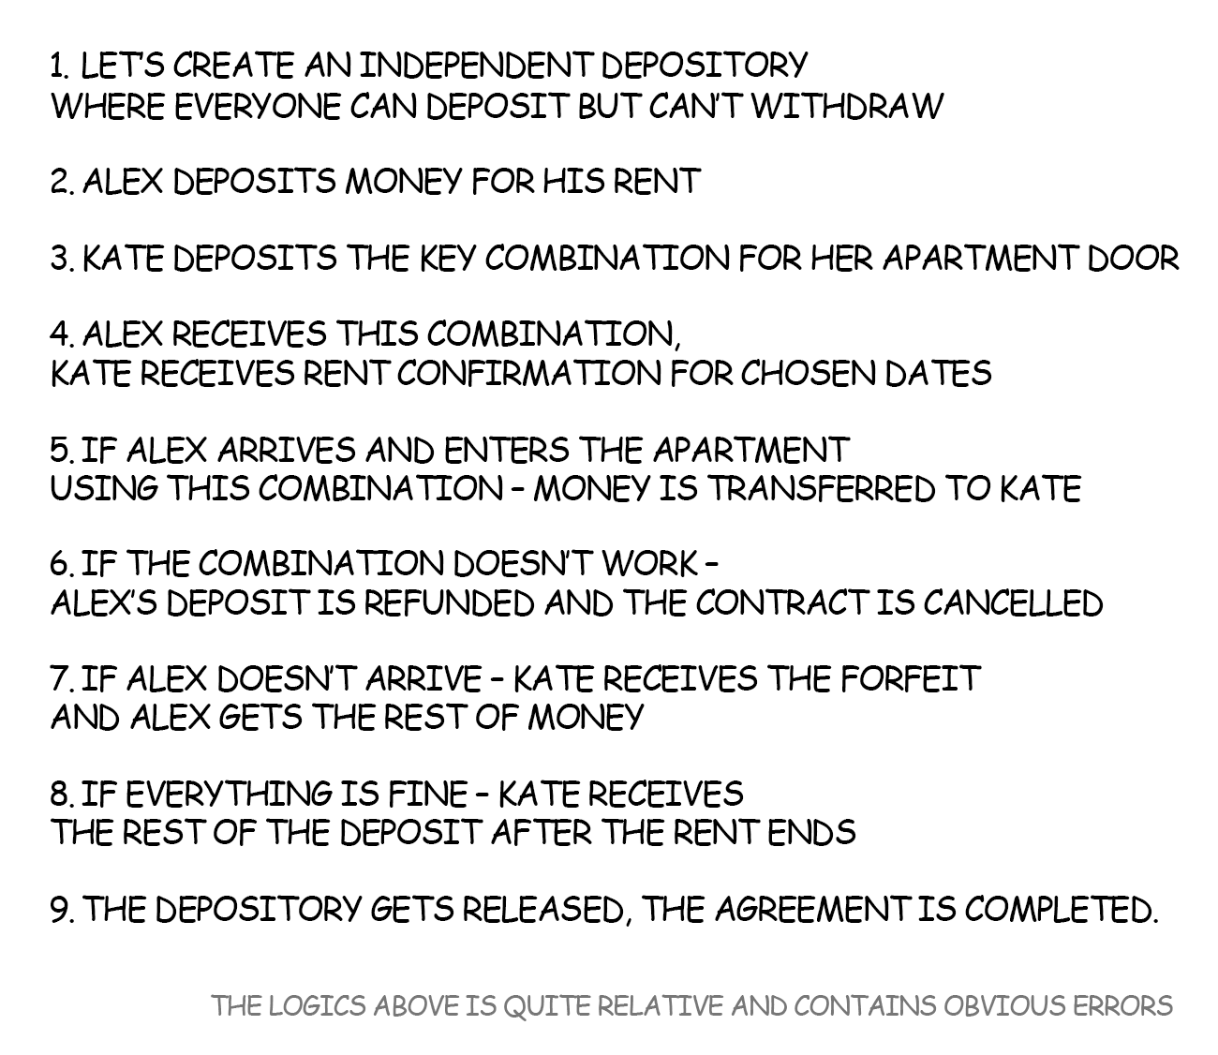

Slide 25
A Smart Contract?
Can this be done using bitcoin?
Bitcoin has a scripting language
  Built for Bitcoin (inspired by Forth)
  Simple, compact
  Support for cryptography
  Stack-based
  Limits on time/memory
  No looping

Slide 26

Example 1: Escrow transactions
(disputed case)
(normal case)
Pay x to Bob
SIGNED(ALICE, BOB)
Pay x to Alice
SIGNED(ALICE, JUDY)
Judy
To: Alice
From: Bob
PROBLEM: Alice wants to buy online from Bob. Alice doesn’t want to pay until after Bob ships.
Bob doesn’t want to ship until after Alice pays.
Alice
Pay x to 2-of-3 of Alice, Bob, Judy (MULTISIG)
SIGNED(ALICE)
Bob
Notes:
Gavel from OpenClipArt.com

Slide 27
Bitcoin scripts in practice
Most nodes whitelist known scripts
99.9% are simple signature checks
~0.01% are MULTISIG
~0.01% are Pay-to-Script-Hash
Remainder are errors, proof-of-burn

Slide 28
Smart Contracts - Ethereum
It is possible to create similar contract using solidity
  One of the languages for writing smart contract!!
  The language is Turing-Complete and it’s possible to implement any programmable logic.
  It has variables, functions, conditions, loops and even some imitation of classes and inheritance.

Slide 29
Smart Contracts - Ethereum
Once you write a contract, it is placed on the blockchain. Even having own address.
This alex-to-kate contract lives in the blockchain forever.
It can be invoked multiple times for bob-to-kate and charlie-to-kate and even alice-to-bob rentals.

Slide 30
Who and How Executes Smart Contracts?
Bitcoin Scripts

Slide 31
How bitcoin scripts are executed?
A transaction is validated by miners before it gets into the block and chain.
We know how it works?

Slide 32
Input “addresses” are also scripts
30440220...
0467d2c9...
scriptSig
OP_DUP
OP_HASH160
69e02e18...
OP_EQUALVERIFY OP_CHECKSIG
scriptPubKey
TO VERIFY: Concatenated script must execute completely with no errors

Slide 33
Bitcoin script execution example
✓
<pubKeyHash?>
<pubKey>
<pubKeyHash>
<pubKey>
<sig>
true
<sig> <pubKey> OP_DUP OP_HASH160 <pubKeyHash?> OP_EQUALVERIFY OP_CHECKSIG

Slide 34
Who and How Executes Smart Contracts?

Slide 35
Where are Smart Contracts deployed?
On the Ethereum blockchain and they have an address as well!
A contract can be executed by making any network transaction to its address.

Slide 36
Who executes Smart Contracts?
In our example, contract once deployed lives in the blockchain.
It is executed when Alex makes a transaction. The contract may call other contracts. The resulting state is saved in the blockchain.

Slide 37
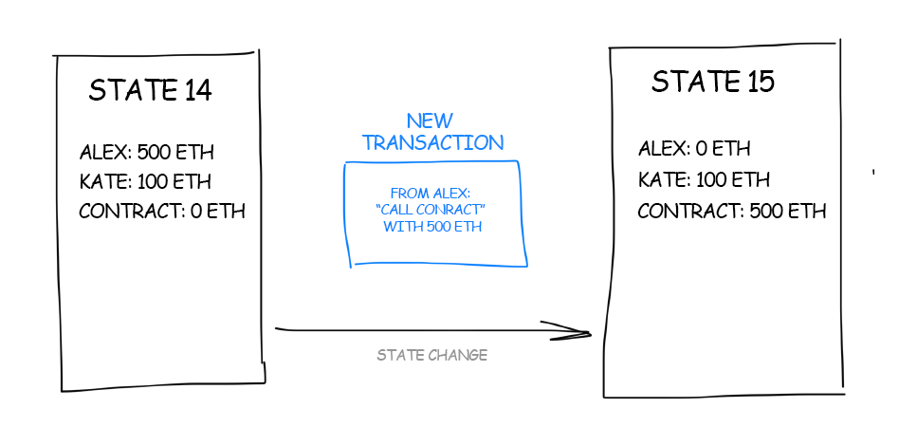

Slide 38
Who executes Smart Contracts?
Who executes the smart contract?
We know, who validates the bitcoin transactions?

Slide 39
How Smart Contracts are executed?
How the Bitcoin scripts are executed?
Recall, it is a stack based language
For a turing complete language, we need a lot more than that.
Ethereum uses EVM (Ethereum Virtual Machine).

Slide 40
Ethereum and Turing Completeness
Ethereum, they say, unlike Bitcoin, is Turing complete. What exactly does that mean?
Turing completeness is very easy to achieve
However, it is very dangerous, particularly in open access systems like public blockchains, because of the halting problem.
Notes:
Turing completeness is a concept in computer science and computational theory that refers to the capability of a computational system or model to perform any computation that can be described algorithmically. If a system or model is Turing complete, it means that it has the computational power to simulate a Turing machine (as described in the previous response) and, by extension, can solve any problem that can be solved algorithmically.
Here are the key characteristics of Turing completeness:
1. **Universal Computation:** A system or model is considered Turing complete if it can simulate a Turing machine, meaning it can perform all the fundamental operations and computations that a Turing machine can.
2. **Algorithmic Expressiveness:** Being Turing complete implies that a system can express and execute any algorithm that is logically and algorithmically defined, without limitation.
3. **Looping and Conditional Logic:** A Turing-complete system must support looping constructs (such as "for" and "while" loops) and conditional statements (like "if" statements) to be able to perform arbitrary computations.
4. **Data Storage and Manipulation:** It should have the ability to store and manipulate data, typically using variables and data structures, to perform a wide range of computations.
5. **Recursion:** Turing completeness often involves supporting recursive functions or procedures, allowing computations to be defined in terms of themselves.
It's important to note that the concept of Turing completeness is theoretical and not tied to practical considerations. In practice, many programming languages, scripting languages, and computational systems are Turing complete, including well-known languages like Python, C++, and JavaScript. The concept helps establish the foundation of computational theory and provides a framework for reasoning about the capabilities and limitations of computational systems.
In summary, Turing completeness is a fundamental concept in computer science that indicates a system's ability to perform any algorithmic computation, demonstrating its computational universality. This concept underpins the theory of computation and is central to the design and analysis of programming languages and computational models.

Slide 41
Turing Completeness as a “Feature”
The halting problem is the problem of determining, from a description of an arbitrary computer program and an input, whether the program will finish running, or continue to run forever.
So can it be solved?

Slide 42
Implications of Turing Completeness
Turing proved that you cannot predict whether a program will terminate by simulating it on a computer.
In simple terms, we cannot predict the path of a program without running it.

Slide 43
Turing Completeness as a “Feature”
The fact that Ethereum is Turing complete means that any program of any complexity can be computed by Ethereum.
Turing-complete systems can run in “infinite loops,” a term used to describe a program that does not terminate.
It is trivial to create a program that runs a loop that never ends.

Slide 44
Implications of Turing Completeness
But unintended never-ending loops can arise without warning, due to complex interactions between the starting conditions and the code.
In Ethereum, this poses a challenge: every participating node (client) must validate every transaction, running any smart contracts it calls.

Slide 45
Implications of Turing Completeness
Whether by accident or on purpose, a smart contract can be created such that it runs forever when a node attempts to validate it.
This is effectively a DoS attack.

Slide 46
What can be done then?
In a world computer, a program that abuses resources gets to abuse the world’s resources.
How does Ethereum constrain the resources used by a smart contract if it cannot predict resource use in advance?

Slide 47
Transaction Gas
Ethereum introduces a metering mechanism called gas. As the EVM executes a smart contract, it carefully accounts for every instruction (computation, data access, etc.).
Each instruction has a predetermined cost in units of gas.
When a transaction triggers the execution of a smart contract, it must include an amount of gas that sets the upper limit of what can be consumed running the smart contract.

Slide 48
Implications of Turing Completeness
The EVM will terminate execution if the amount of gas consumed by computation exceeds the gas available in the transaction.
Gas is the mechanism Ethereum uses to allow Turing-complete computation while limiting the resources that any program can consume.

Slide 49
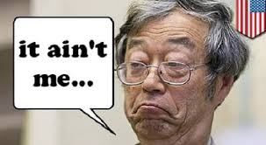
Who developed Ethereum?
Satoshi Nakamoto? No ☺

Slide 50

Who developed Ethereum?
Fortunately, this time we have someone to thank!
Vitalik Buterin, Gavin Wood, Joseph Lubin

Slide 51
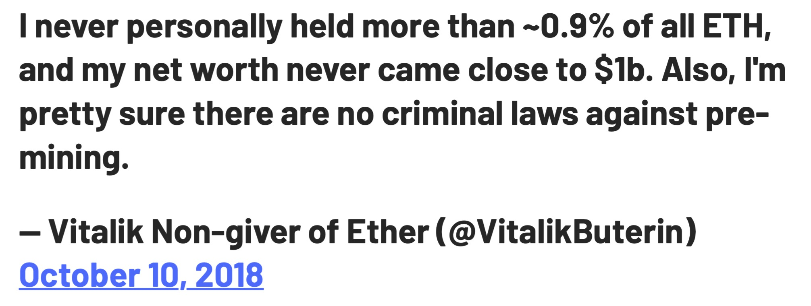
Who developed Ethereum?
How many Ethers he owns ? ☺

Slide 52
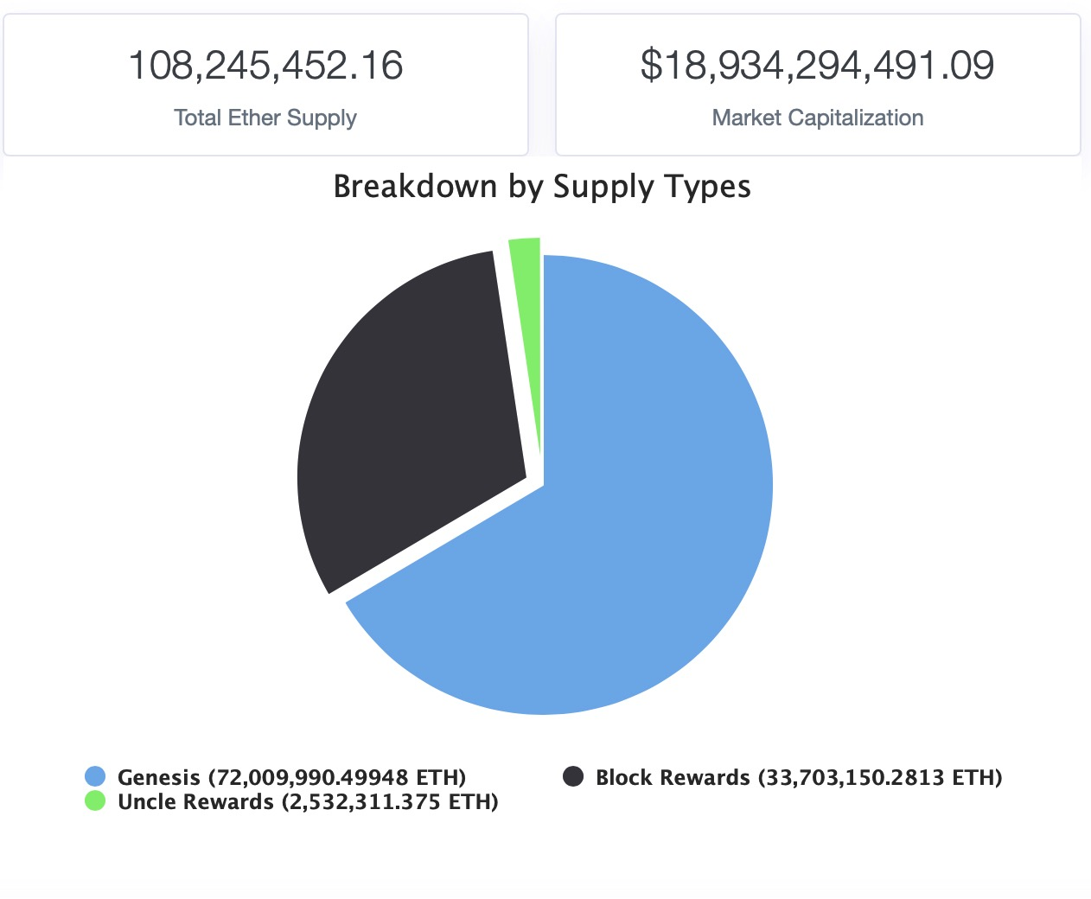
Ethereum Pre-mining

